Slide 1
Adding Organizations and Roles as Primitives to the JADE Framework
M. Baldoni, V. Genovese, R. Grenna and L. van der Torre
Presented by Beerend Lauwers, Utrecht University

Slide 2
Overview
Organizations?
Model of Organizations and Roles
Definition: Roles
Implementation
Role Class
Organization Class
Player Class
Interaction Overview
Conclusions

Slide 3
Organizations?
Coordinate open MAS
Provide control of access rights
Allow for heterogenous agents
Good abstractions for modelling real world institutions
Several frameworks are available, but...
Only a few support organizations and roles
No common conceptual model of an organization
How do agents interact with organizations and roles?

Slide 4
Model of Organizations and Roles
Organizations and roles are not autonomous
Roles depend on its organization
Organizations and roles describe complex behaviours
Several agent-like properties
Builds upon previous paper (Organizations as socially constructed agents in the agent oriented paradigm, G. Boella and L. van der Torre)

Slide 5
Definition: Roles
Are entities
Role Instance: role executed by an agent
Role Type: specification of the role
Have goals and beliefs
Can extend an agent’s abilities (“Powers”)
Can have requirements
Can only be instantiated if there is an organization that offers it
Communication influences state of the role
Allow for encapsulation of interaction between agents, organizations and role players

Slide 6
Definition: Roles (cont.)
Roles allow for
Structuring the organization
Distributing responsibilities
Coordination
Roles and organizations are agents with limited autonomy
Note: Agents can have multiple roles, but only a single role is active at a time

Slide 7
Implementation
Implemented in the JADE (Java Agent DEvelopment) framework
Extend Agent class
Organization
Role
Player
Communication between roles, organizations and role players is made possible
Agents can be on a different platform than roles and organizations
Non-JADE agents can play roles in organizations

Slide 8
Implementation – Role Class
Role class extensions represent role types
Has protocols to communicate with role player
Receive requests
Invoke a power
Deact role
Inform role player
Execute requirement and receive result
Power execution failure
Failure to receive requirement results
Can modify state of its organization
Uses inner- and outer class concept of Java
Limitation: Roles must be on same platform as its organization
Can be registered in the Yellow Pages for agent search

Slide 9
Implementation – Organization class
Organization instance can offer roles
Has protocols to communicate with agent who wishes to play a role:
Agent informs organization that it wishes to play a role
Organization checks if player is authorized
Organization returns list of powers and requirements
Agent checks if he can play the role (=enacting)
On organization destruction, all its roles are destroyed

Slide 10
Implementation – Player class
Models role playing states (enact, active, deactivated, deacted)
Handles state transitions
Has protocols to communicate with organizations and roles
Protocol instance for each role played
Decides requirement execution

Slide 11
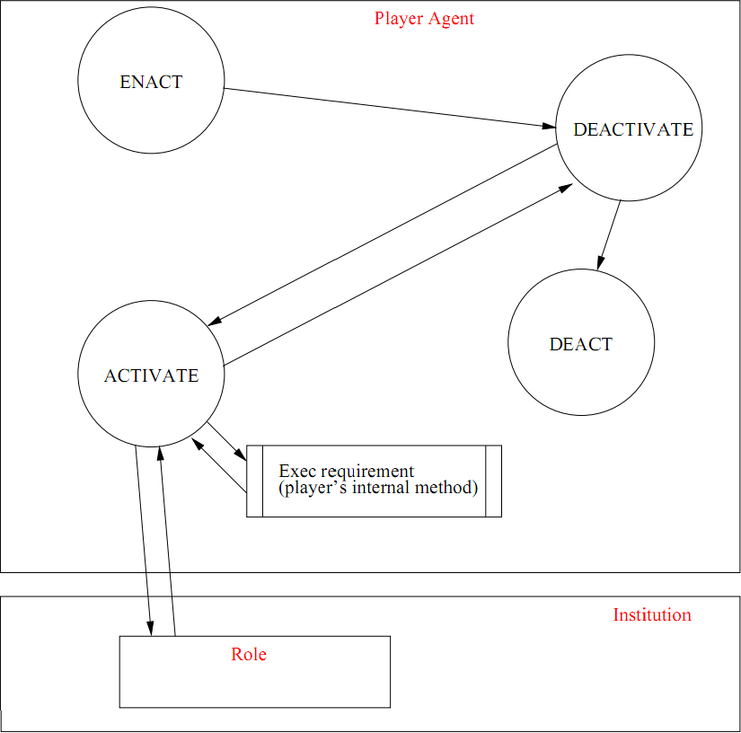
Implementation – Role playing states

Slide 12
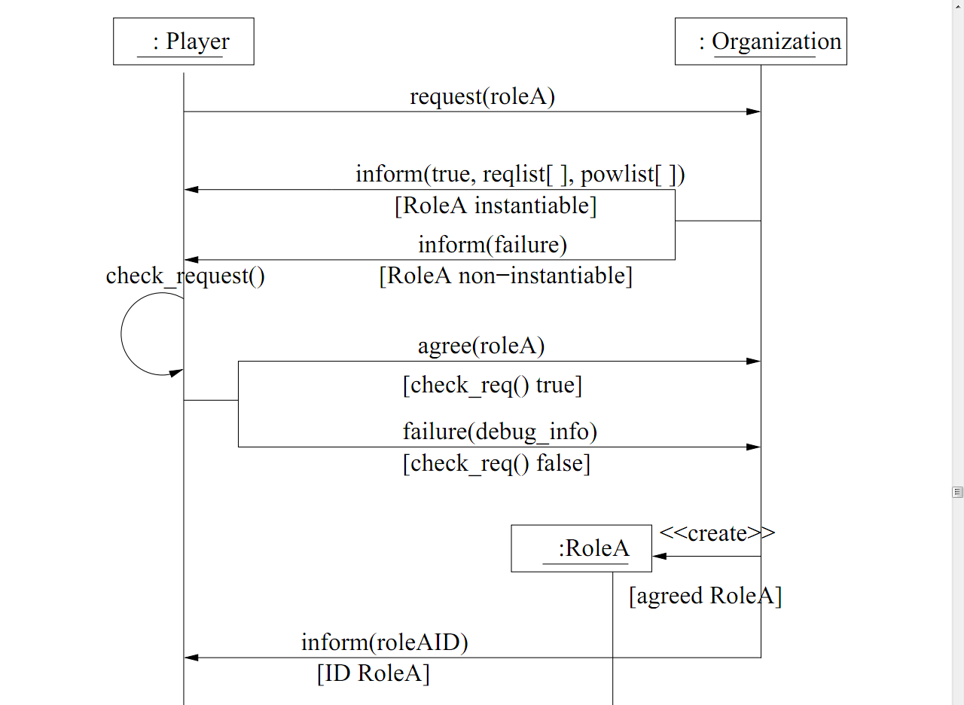
Interaction Overview

Slide 13
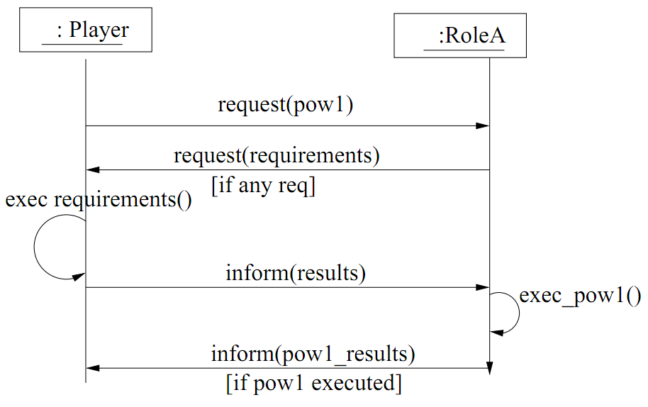
Interaction Overview (cont.)

Slide 14
Conclusions
Organizations and roles
Are agents with limited autonomy
Implemented by extending the Agent class of JADE
Can be on a different platform from the agents
Protocol-based communication ensures agent autonomy (instead of direct method calling)

Slide 15
Thank You

